Slide 1
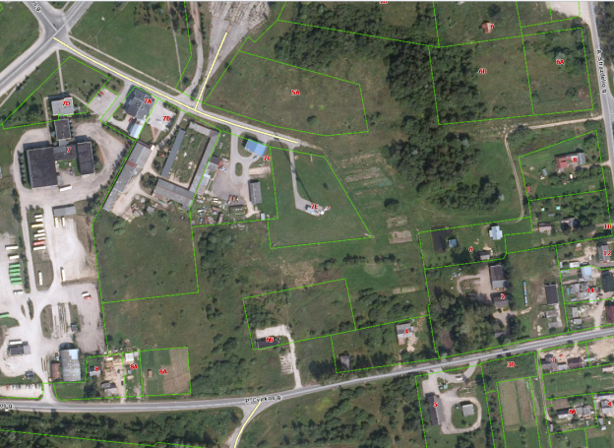

Commercial Land
Rokiskis District Municipality Administration
Plan of the land Photo of the land
Address | Rokiskis town, P.Cvirkos – Miškininkų str. prolongation 1
Lot size | 0,3849 Ha
Electricity | 200m distance to substation of power system
Water | 100 m, d100 mm distance to water network
Telecommunications | 40 m distance to internet, telephone network
Distance to the main road | 0,04Km
Price/other conditions | Has not offerred for sale at an auction Detailed plan has prepared Land is commercial

